Slide 1
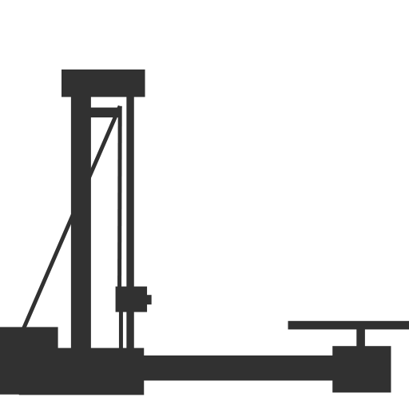
Budget 3D Scanner Project
(Redistribution Edition - Open Source Project)
Hardware & Arduino Programming: Toby
Post-processing & Optimization: Andy

Slide 2

Introduction
3D Scanners are kind of expensive right now but it has a wide range of application
We want to make a low cost 3D scanner with ToF Sensor and two stepper motors as Proof of Concept
Aim as create somewhat observable 3D models from one single sensor by converting the sensor data into point clouds that construct the 3D model

Slide 3
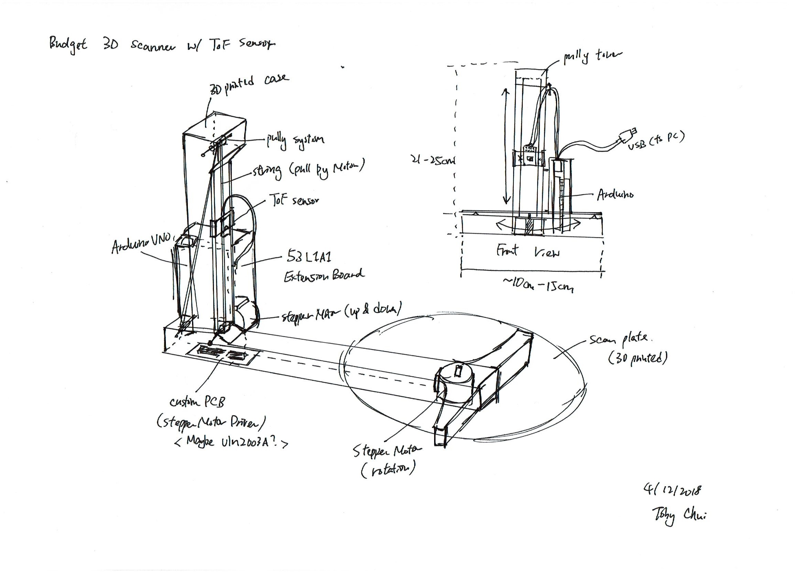
Design Sketch
Draft design of the scanner, designed to be completely 3D printable and cheap to build.

Slide 4
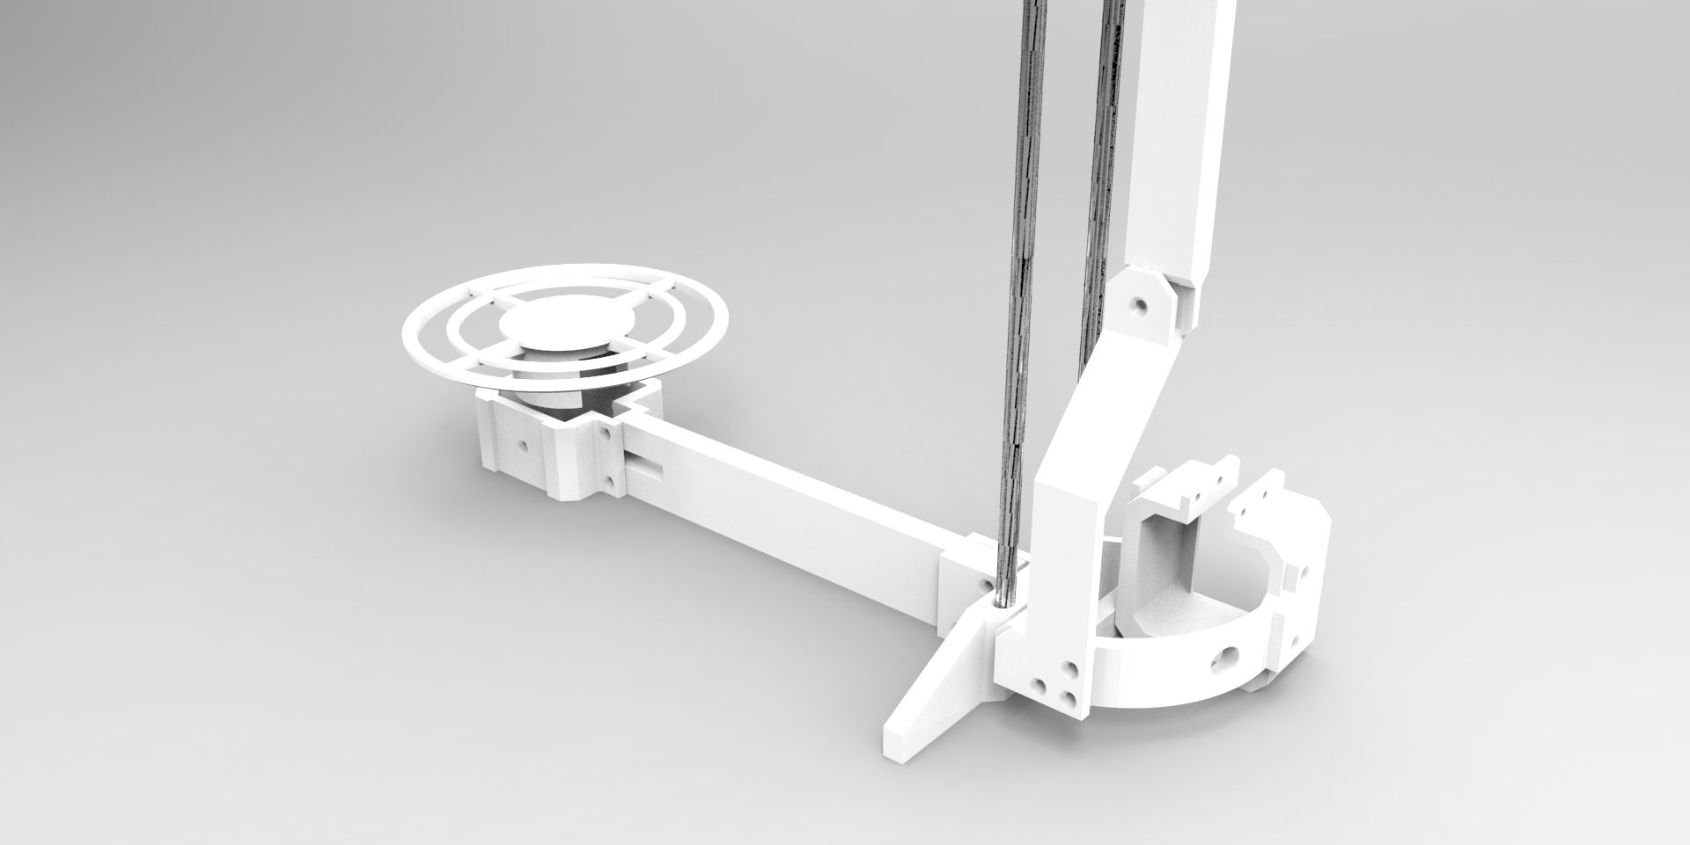
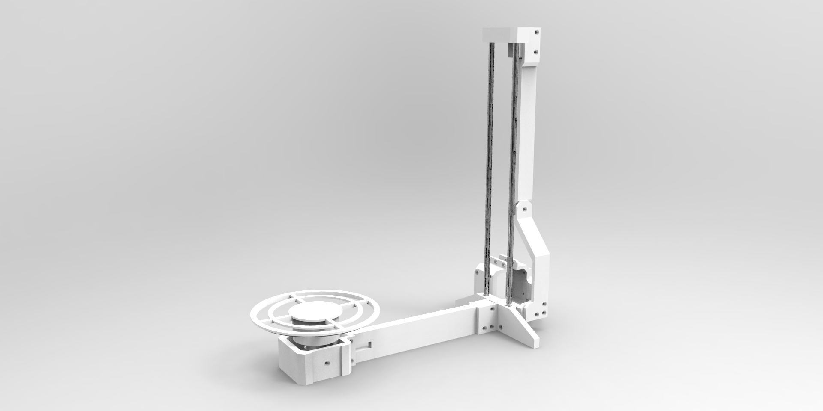
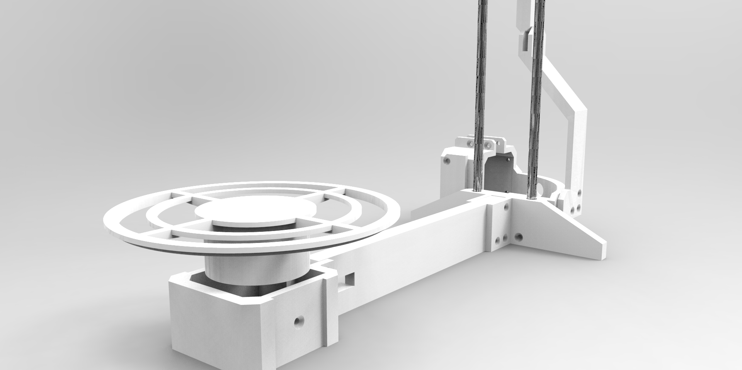
3D modeling (and render)

Slide 5
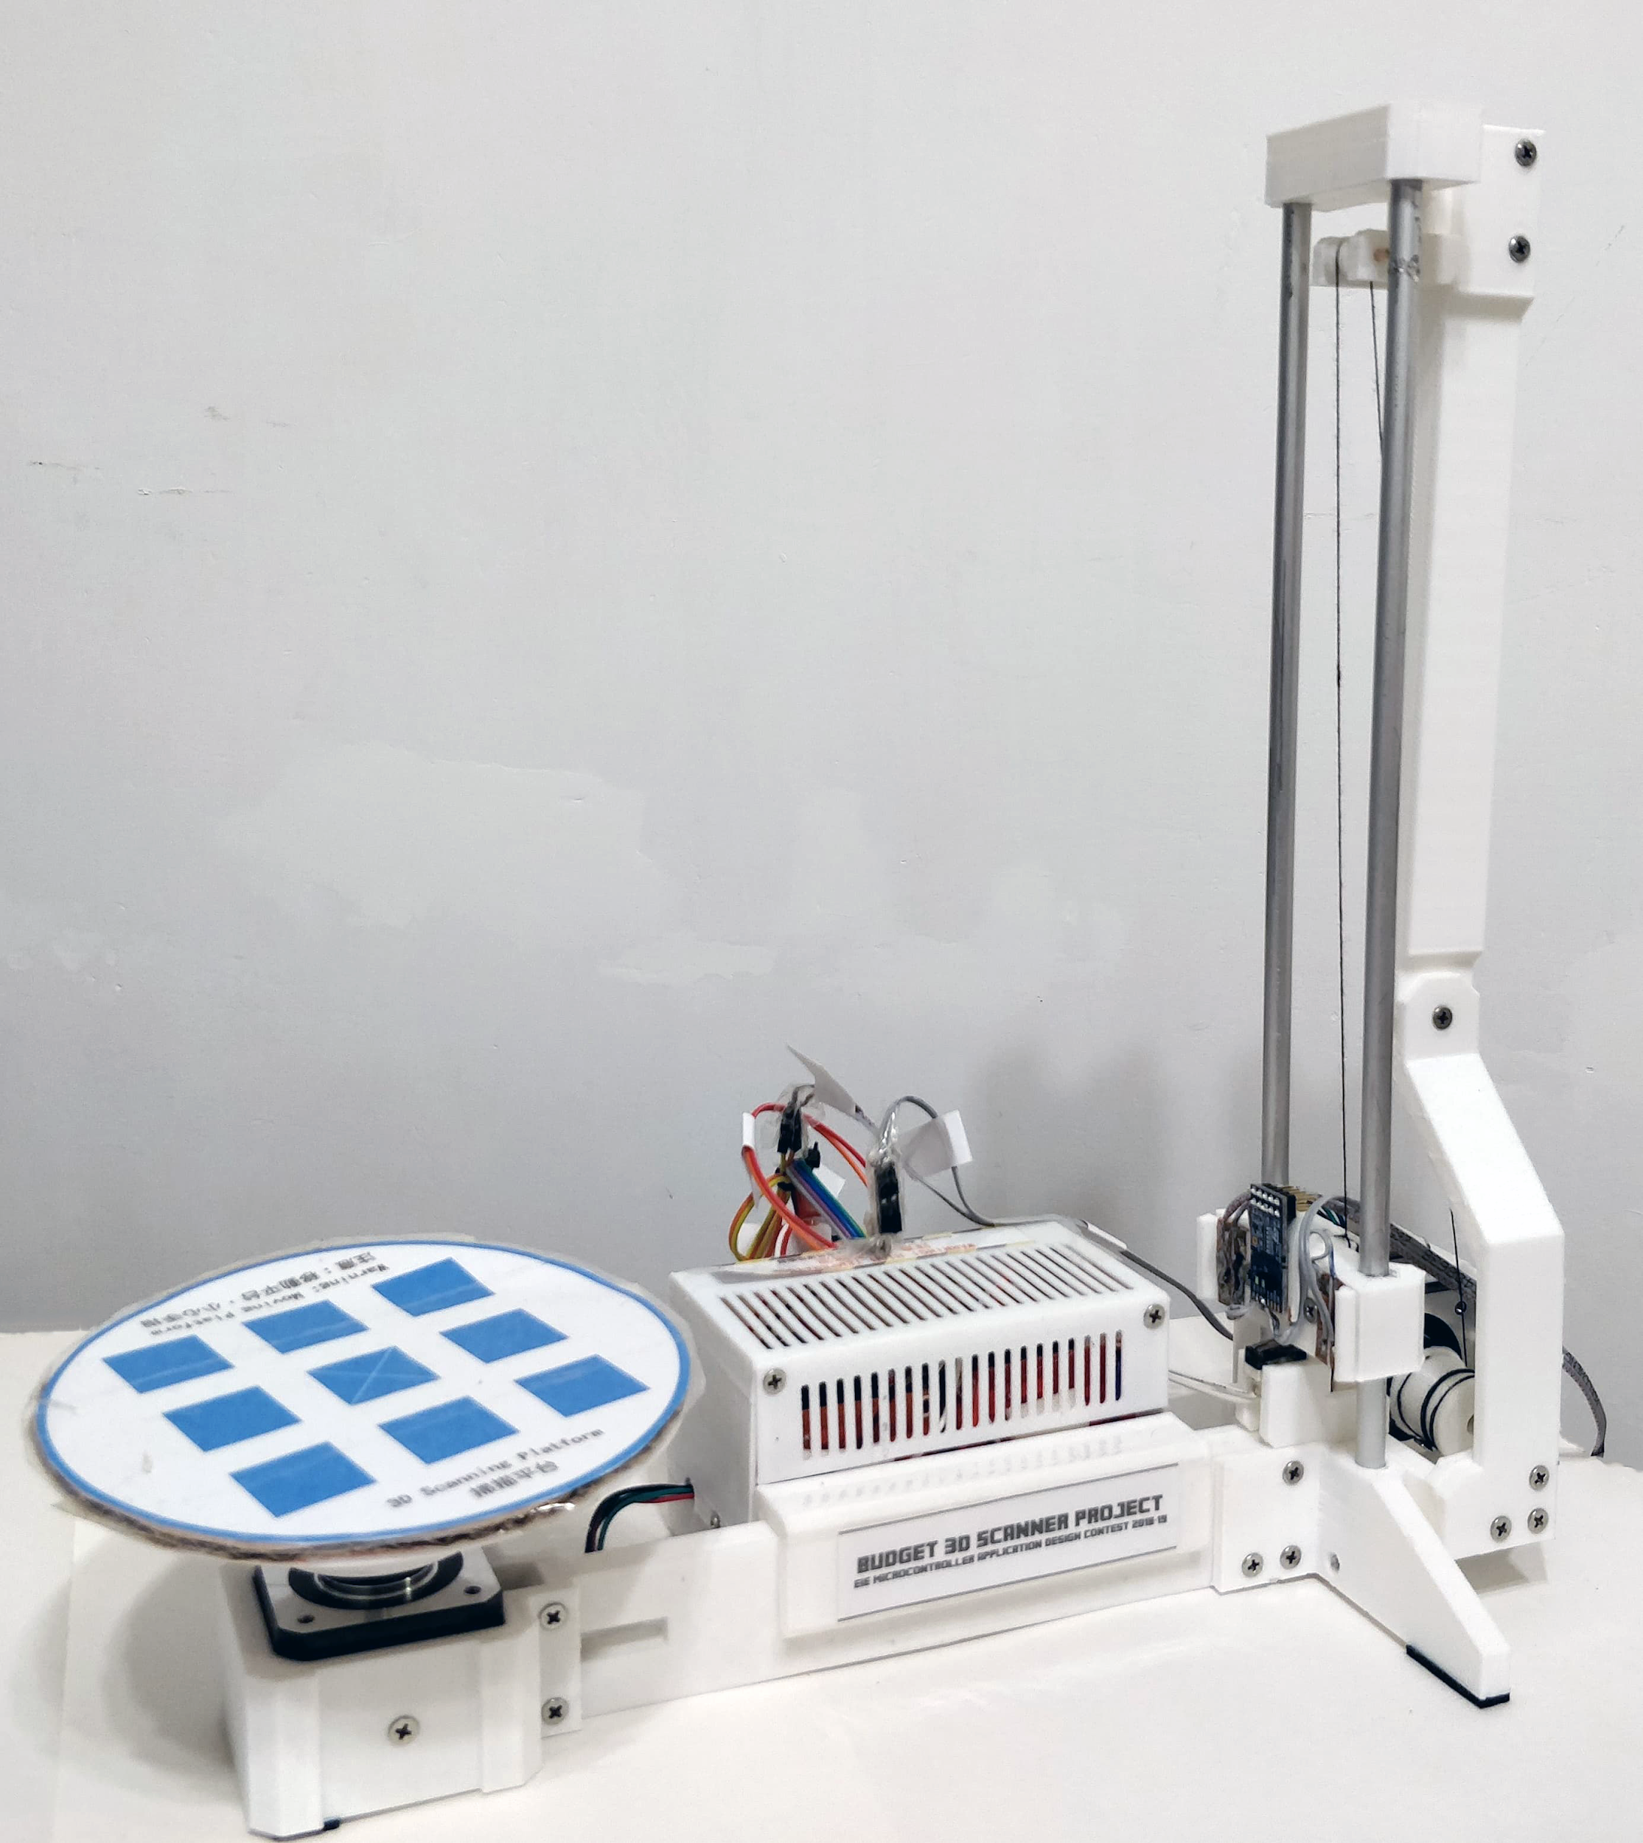
Final Product (Scanner)
Specification:
VL53L1X ToF Sensor (SHARP GP2D12F) Arduino UNO 2.8V Stepper Motor x2 Many 3D Printed Parts

Slide 6
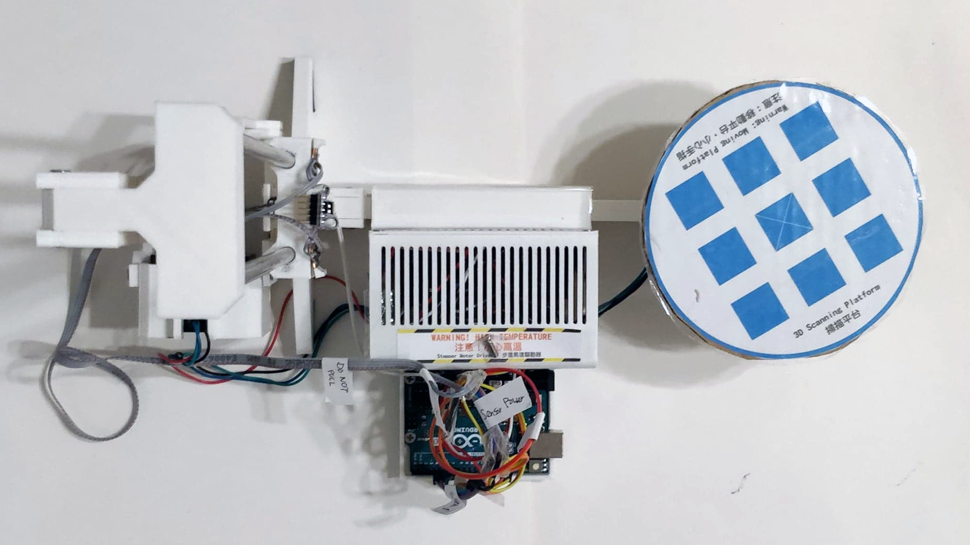
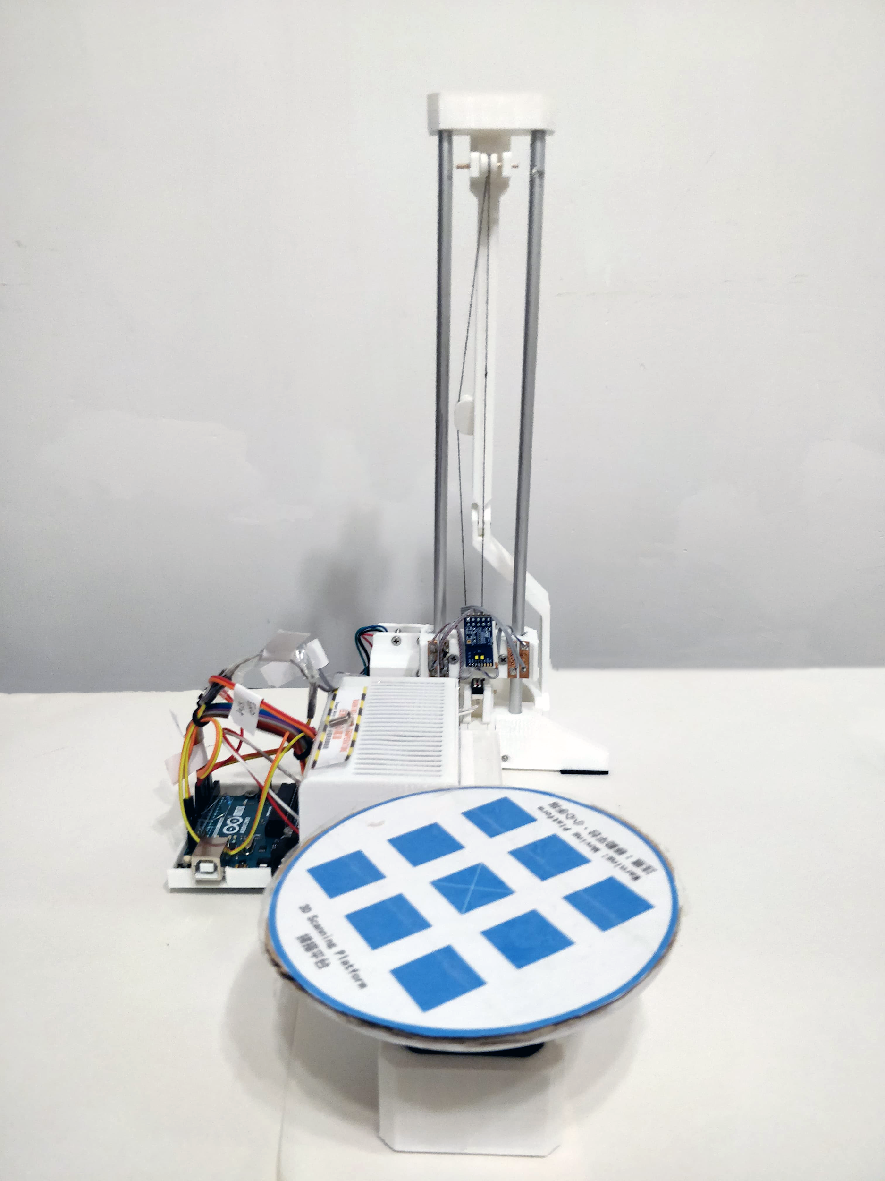
Top View and Front View

Slide 7

Scanner In Action

Slide 8
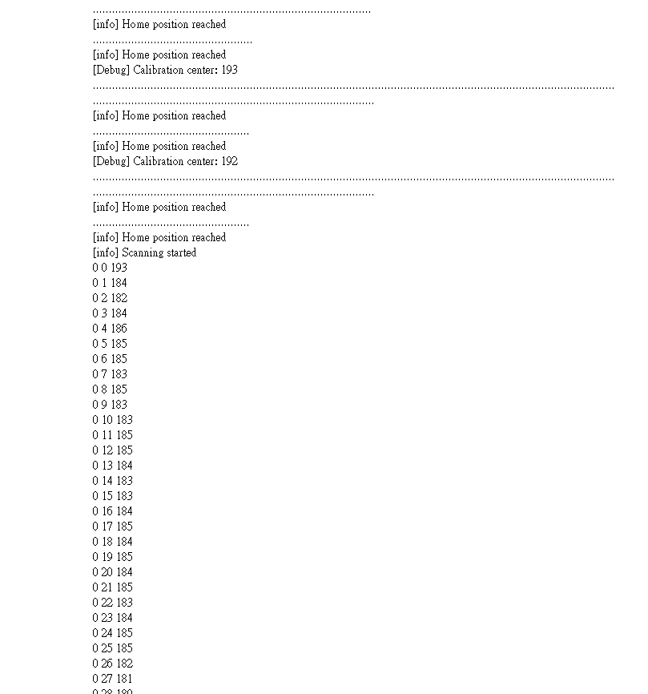
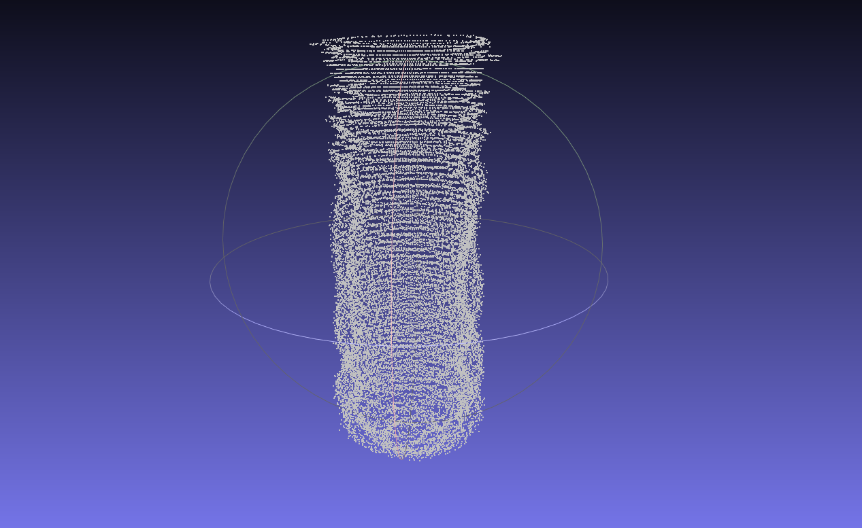
Raw Output of Scanner

Slide 9
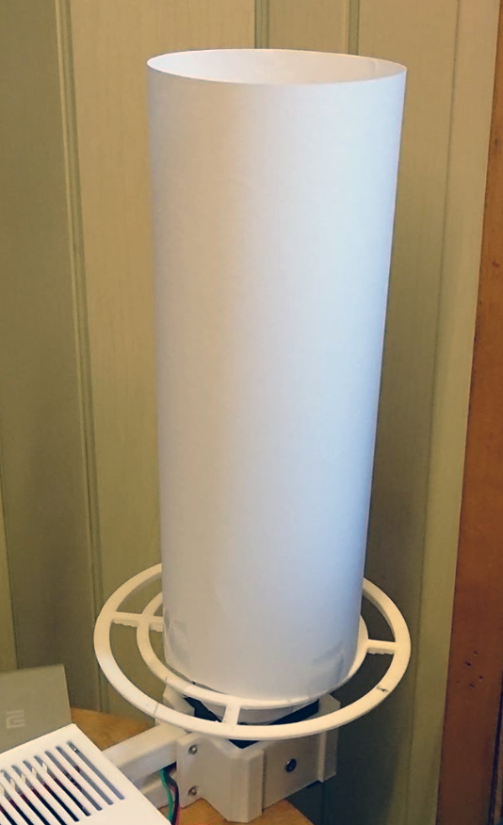
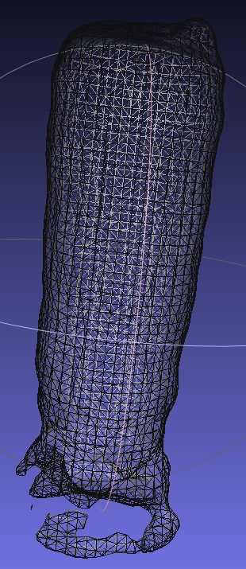
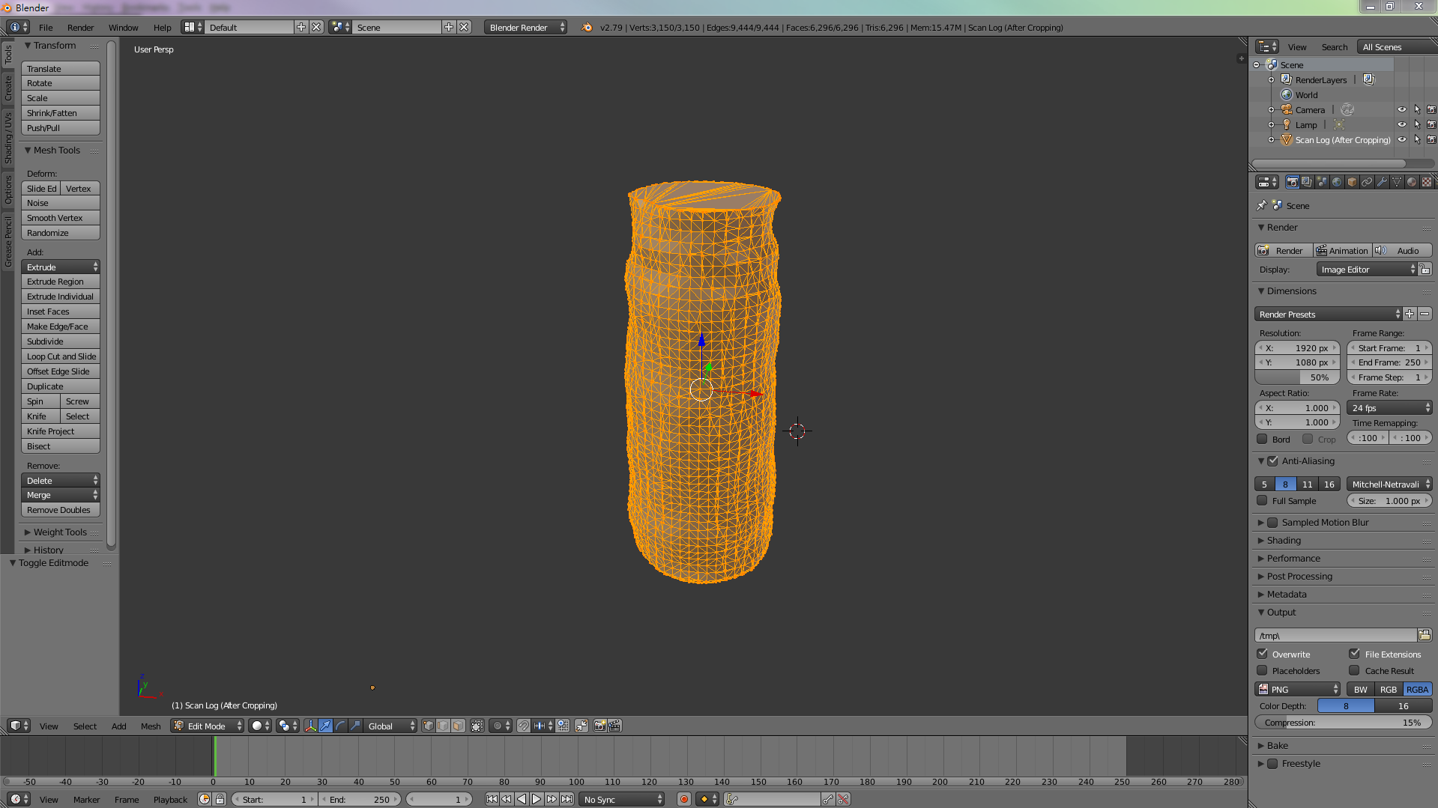
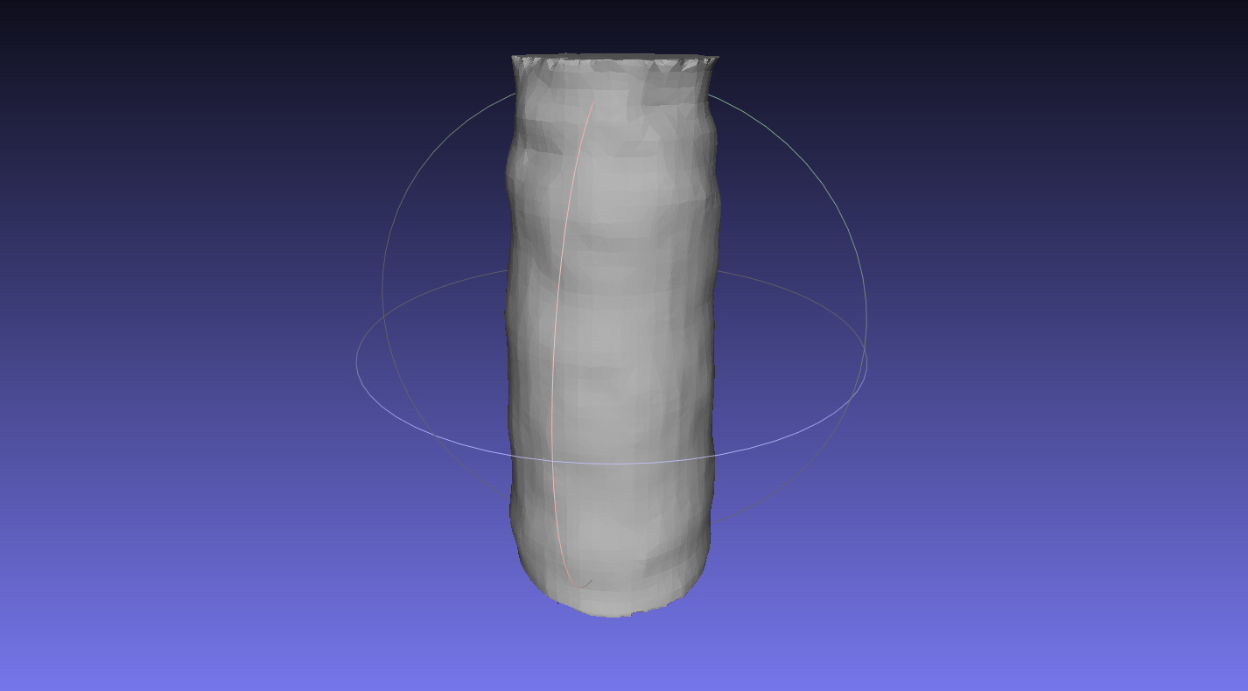
Processed Scan Data

Slide 10
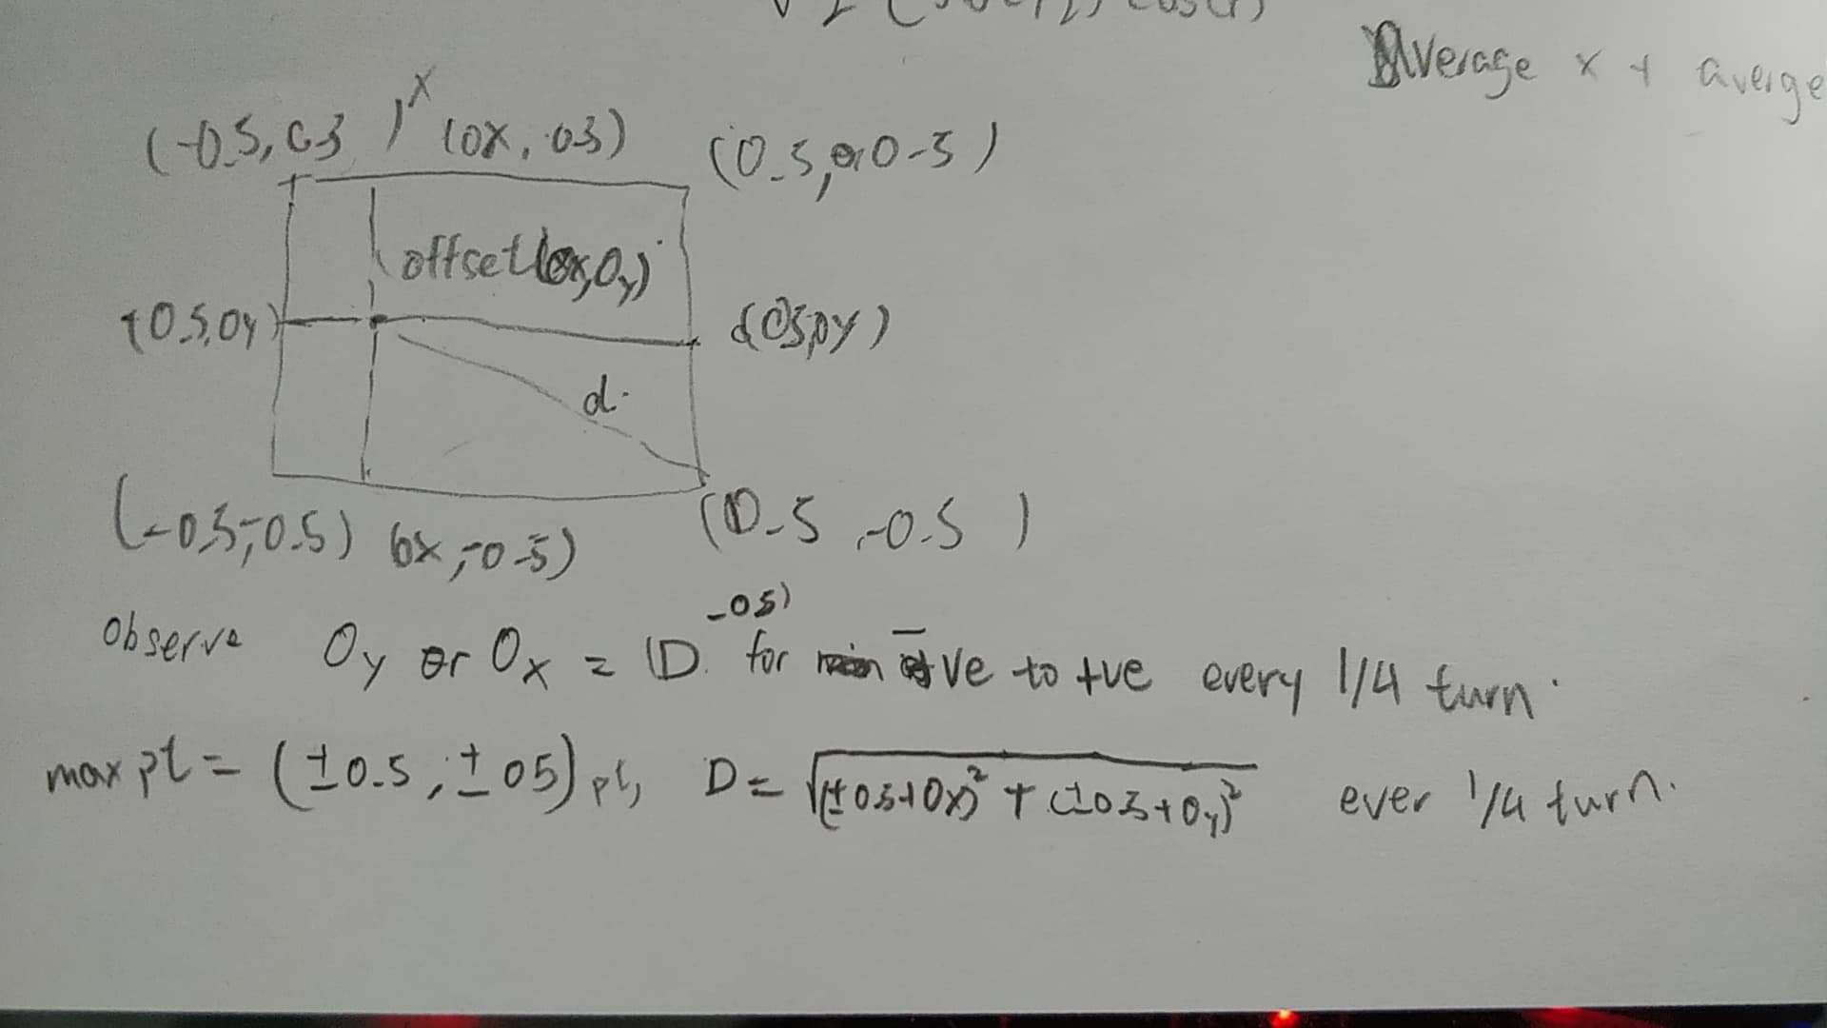
Calibration formula deduction

Slide 11
Assumptions
The placement of calibration box is off centered → unknow center point
The height ratio is straight forward: (top - bottom )/ steps
The depth is the complicated part.
x = depth * sin(theta), y = depth * cos (theta)
But hey the box is off centered and we don’t know any of x and y and theta!

Slide 12
Derive a function that link everything together
D =
(side /2 + Ox) / sin(theta+offset) | 0<= theta <=pi/2
(side /2 - Oy) / sin(theta+offset) | pi/2<= theta <= pi
(side /2 - Ox) / sin(theta+offset) | pi <= theta <= 3pi/2
(side /2 + Oy) / sin(theta+offset) | 3pi/2<= theta <= 2pi
Too complicate, we can go with only local minimum : (sin(theta)=1)
(Ox,Oy)
D

Slide 13
Going through the DARKNESS of calculus
We can eliminate variables using differentiation
d D/ dr = 0 ← solve r and left with 1 unknown
can be approximated by D(r+Δr)-D(r)/Δr
Also need to reject d^2 D/ dr > 0 (local max)

Slide 14
It gots clear at this point
at each local minimum
d_min ± (Ox or Oy) = depth (measured by sensor)
One more trick
let Oy >= Ox
d - Oy <= d - Ox <= d + Ox <= d + Oy
cancel out Oy, done
(Ox,Oy)
D

Slide 15
Cost Summary
Item Name | Amount / Units | Cost (in HKD) | Remarks
3D Printed Parts | Around 700g | $84 | Estimated Material Cost
VL53L1X | 1 | $336 | Replaced with Infrared sensor due to accident
GP2D12 | 1 | $78 | SHARP Infrared sensor
L298N | 2 | $35.3 x 2
Arduino UNO | 1 | $180.52
M3 * 5, M3 * 10, M3 * 20 screws | >20 | Neglectable
 |  | Total (with ToF) | $671.12
 |  | Total (with IR) | $413.12

Slide 16
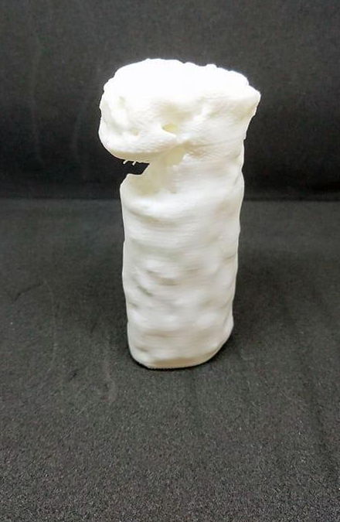
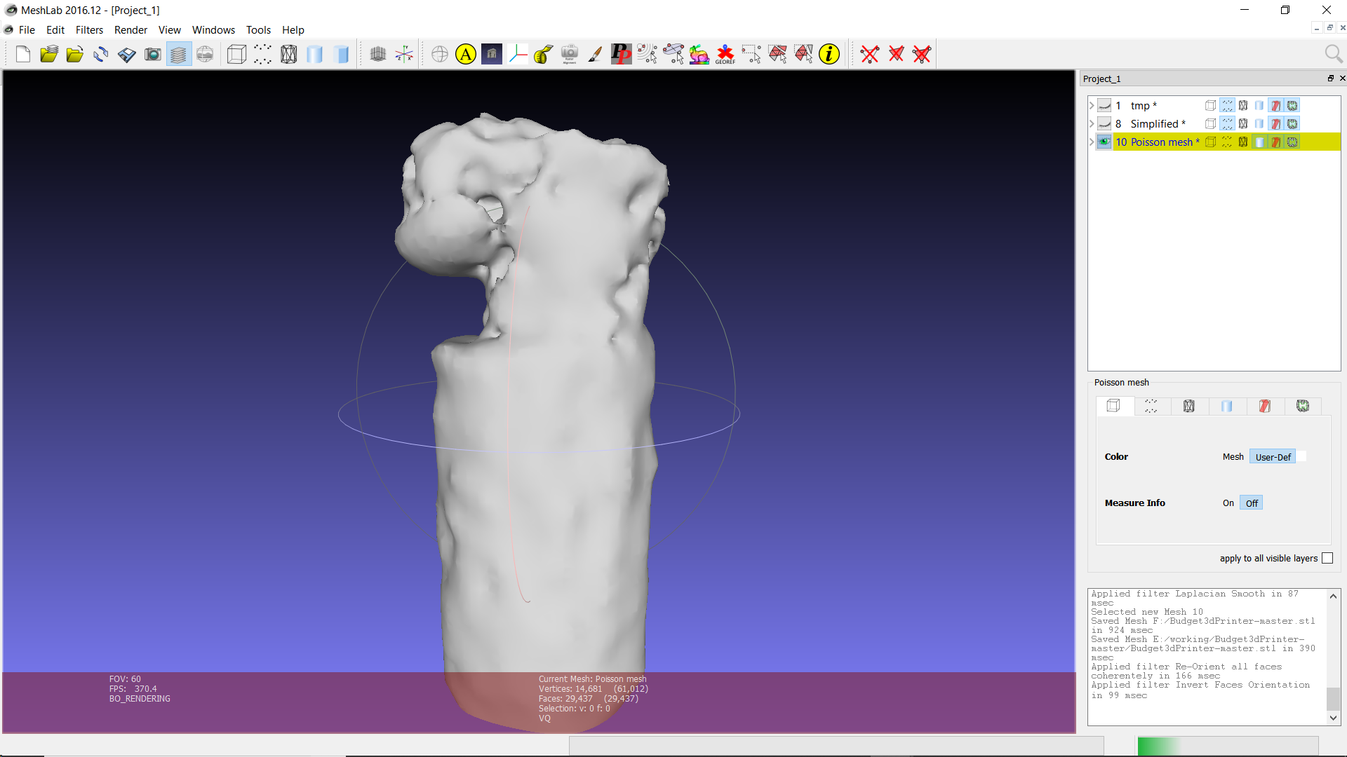
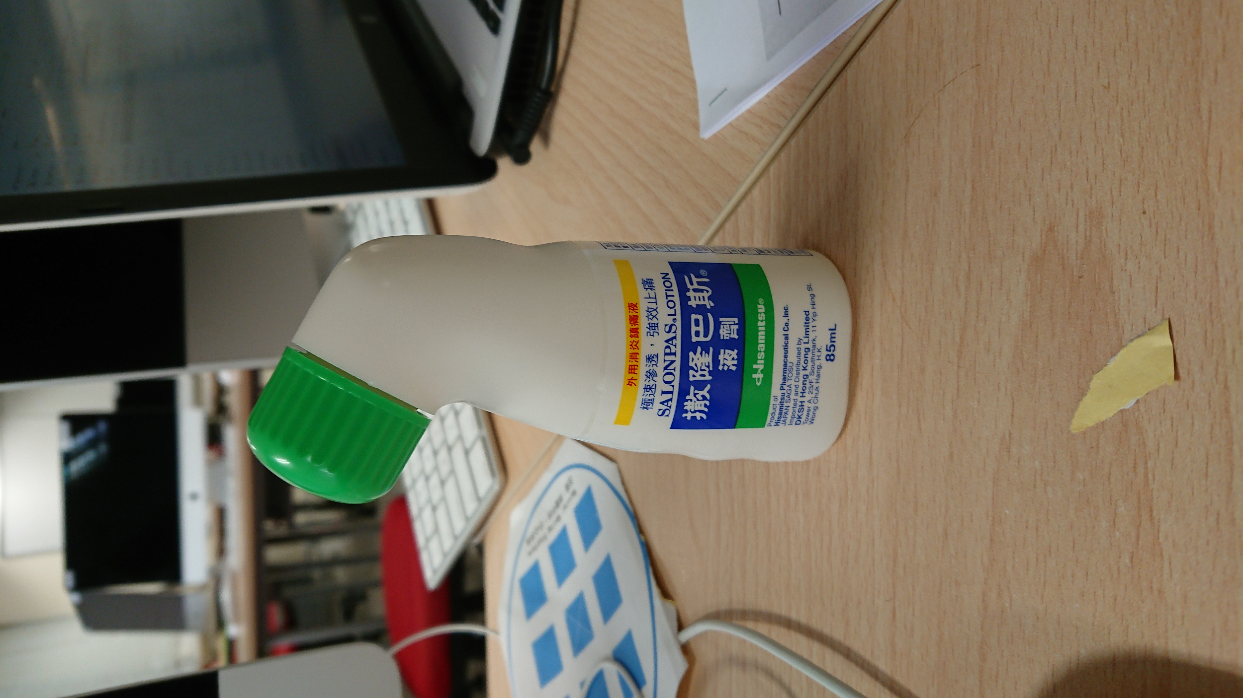
Final Results

Slide 17
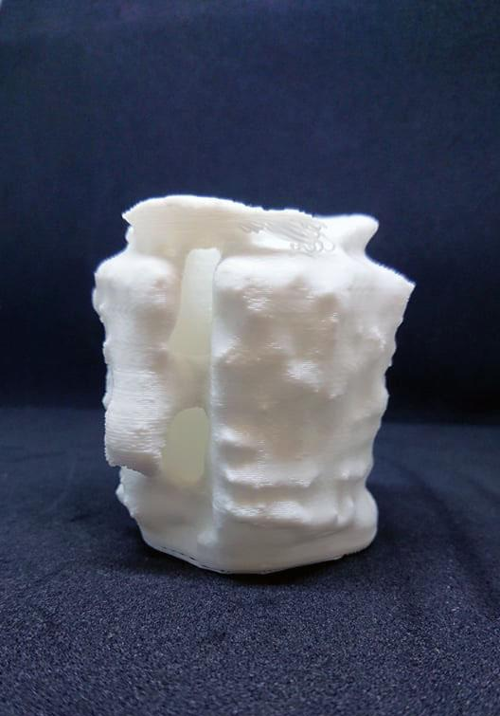
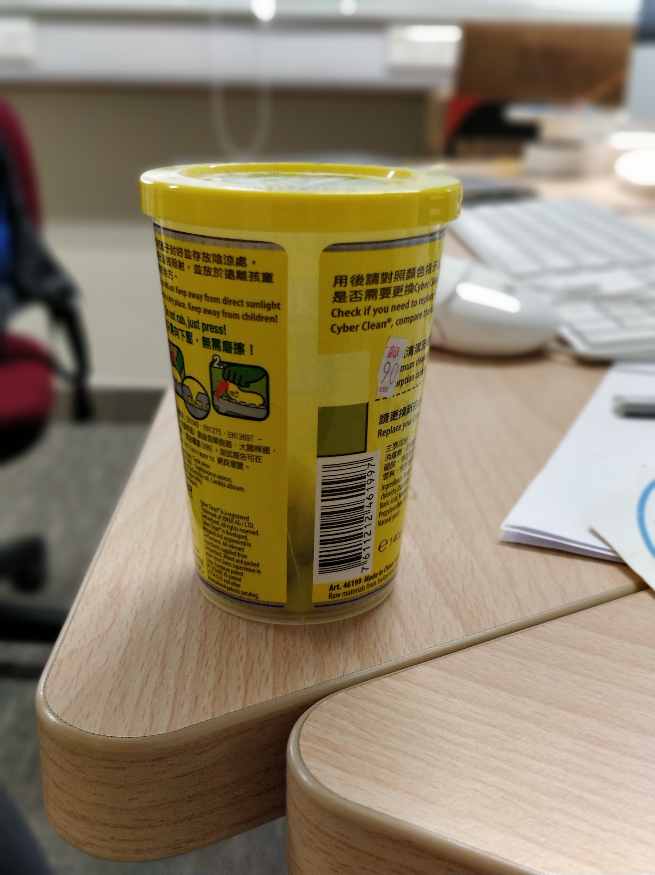
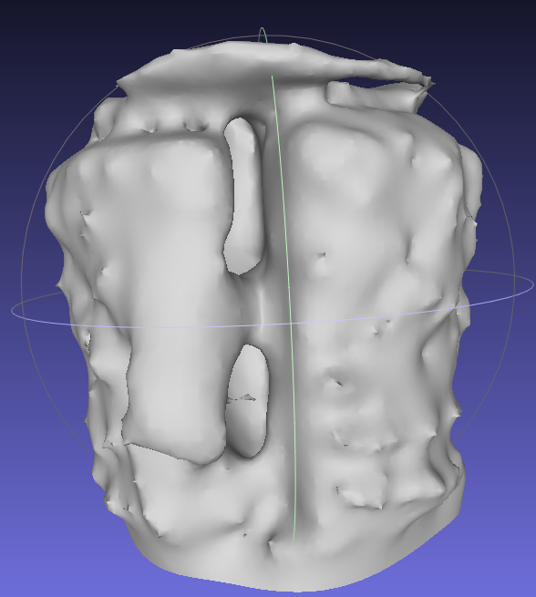
Final Results
Transparent parts that cannot be scanned via IR sensor

Slide 18
Future Development
Use dual sensor mode with Ultrasound Sensor to reduce error from reflection and transparent material
Improve post-processing and scanning accuracy (This ToF Sensor is not the best one to suit this kind of application)
3D Copying Machine! (Scanner directly output gcode for 3D printer to print at the same time)
Open Source

Slide 19
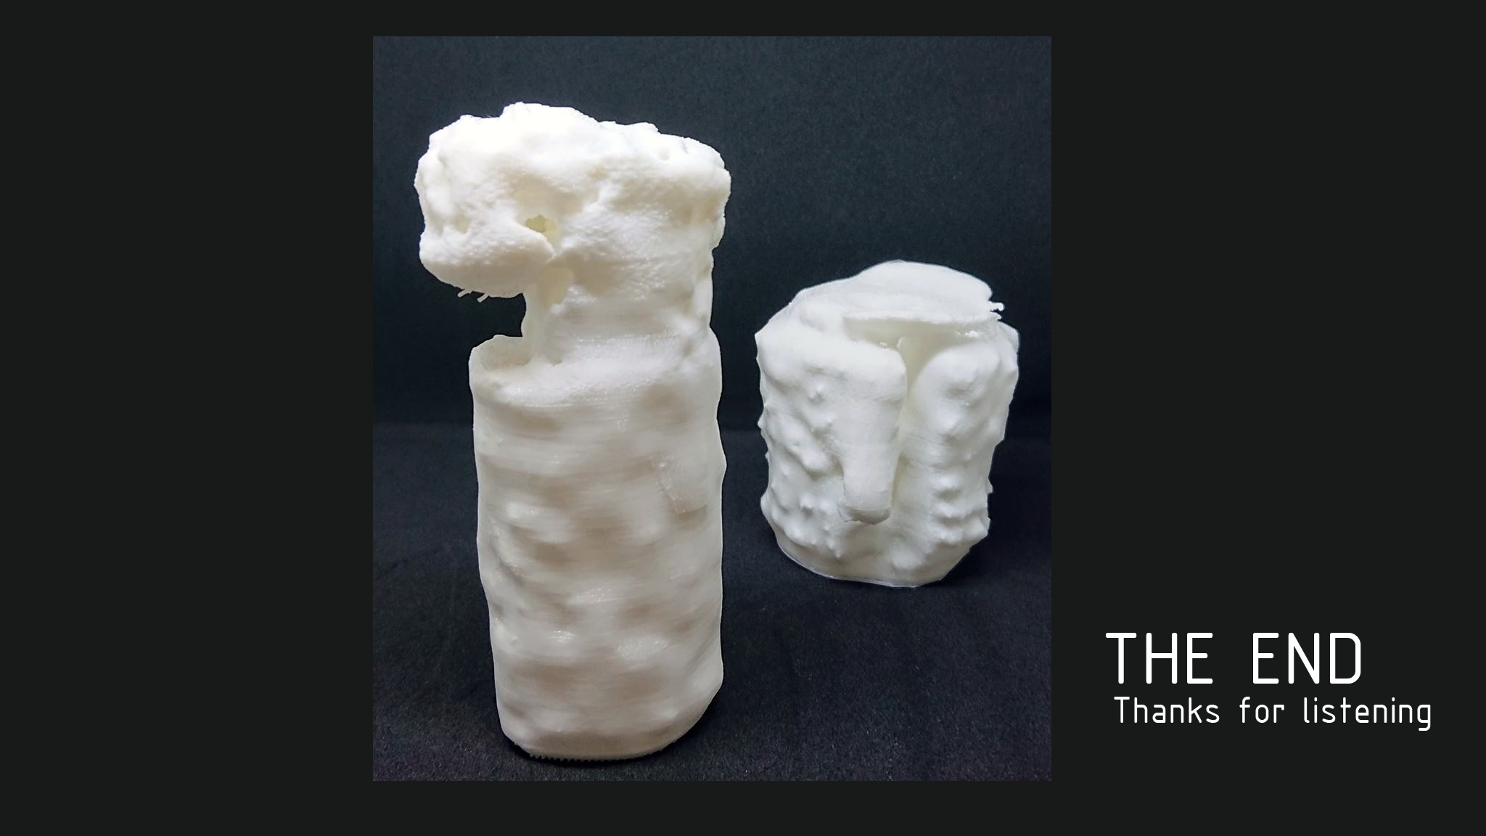
Thank you

Slide 20
Reference and CopyRight
All the content in this powerpoint is copyRight IMUS Laboratory (and its member), All Right Reserved. You can freely distribute this powerpoint with the following restriction
No Commercial Uses
No charge / fees should be involved when distributing this powerpoint and related files inside this project
Toby and Andy (Author of this project) has all right towards this project and all project material. The author will bear any responsibility to the safety, workability, accuracy or other technical or safety related issue regarding this machine.
Ask for permission for usage if you are using this project (and its material) for any purposes except educational and personal uses purpose.
Visit https://www.facebook.com/ImusLaboratory for more information

